Slide 1
JIRA

Slide 2
Contents
What is JIRA?
What is JIRA used for?
How to Use JIRA?
JIRA workflows
Jira Administrator

Slide 3
What is JIRA?
JIRA is an Incident Management Tool used for Project Management, Bug Tracking, Issue Tracking, and Workflow.
JIRA is based on:
  Project
  Issue
  Workflow.

Slide 4
About JIRA
JIRA is developed by Atlassian Inc., an Australian Company.
JIRA is a platform independent tool; it can be used with any OS.
JIRA is multi- language-tool − English, French, German, Japanese, etc.
JIRA supports MySQL, Oracle, PostgreSQL and SQL server in the backend.
JIRA can be integrated with many other tools − Subversion, GIT, Clearcase, Team Foundation Software, Mercury, Concurrent Version System and many more.

Slide 5
What Is JIRA Used For?
Jira Software is part of a family of products designed to help teams of all types manage work.
Originally, Jira was designed as a bug and issue tracker.
But today, Jira has evolved into a powerful work management tool for all kinds of use cases, from requirements and test case management to agile software development.

Slide 6
How to Use JIRA?
Here is a step by step process on how to use Jira software:
  Step 1) Open Jira software and navigate to the Jira Home icon
  Step 2) Select Create project option
  Step 3) Choose a template from the library
  Step 4) Set up the columns as per your need from Board settings
  Step 5) Create an issue
  Step 6) Invite your Team members and start working

Slide 7
JIRA Workflow
A JIRA workflow is an arrangement of statuses and transitions that an issue travels through amid its lifecycle and normally speaks to forms inside your organization.
There are pre-defined built-in workflows that can't be altered; in any case, you can duplicate and utilize these built-in workflows to make your own.

Slide 8
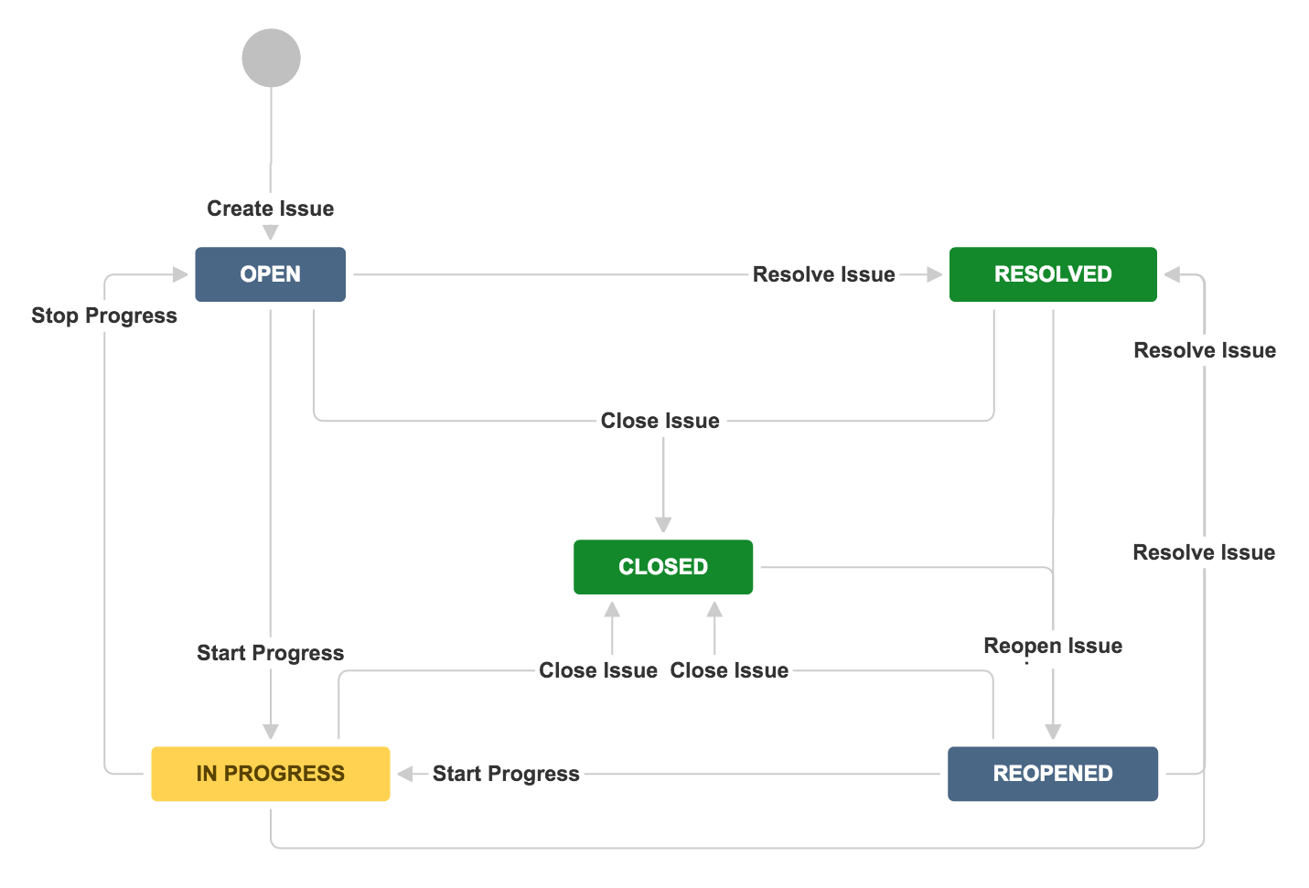
JIRA Workflow Diagram

Slide 9
JIRA Workflow (Cont.)
JIRA Workflow can also be referred to as a defect lifecycle.
  Open issue: When the issue is created, then the issue is assigned to the software developer, and they start working on it.
  In Progress issue: The software developers start working on the issue.
  Resolved issue: Issue is resolved by the software developer but waiting for the verification by the tester. If the verification is successful, then the issue is closed; otherwise, the issue gets reopened.
  Reopened issue: When the software developer did not resolve the issue as per the requirements, then the issue comes in a reopened state.
  Close issue: When the software developer correctly resolves the issue and verified by the software tester, then the issue will be closed.

Slide 10
Jira Administrator
Jira Administrators are responsible for configuring:
  Jira Software
  Jira Core
  And/Or Jira Service Management
  Its related apps
  And third-party tools.

Slide 11
Jira Administrator (Cont.)
They manage global settings including users and groups, roles, global permissions, and schemes.
Additionally, they create projects, set up project permissions, and assign Jira Project Administrators.

Slide 12
Project in JIRA
A Project contains issues; a JIRA project can be called as a collection of issues. A JIRA Project can be of several types. For example −
  Software Development Project
  Marketing Project
  Migration to other platform project
  Help Desk Tracking Project
  Leave Request Management System
  Employee Performance System
  Website Enhancement

Slide 13
Create a New Project in JIRA
To create a project, the user should login as a JIRA Service Desk Admin and then Click on Project → Create Project.
The following screenshot shows how to reach to the Create Project button from the Dashboard.

Slide 14
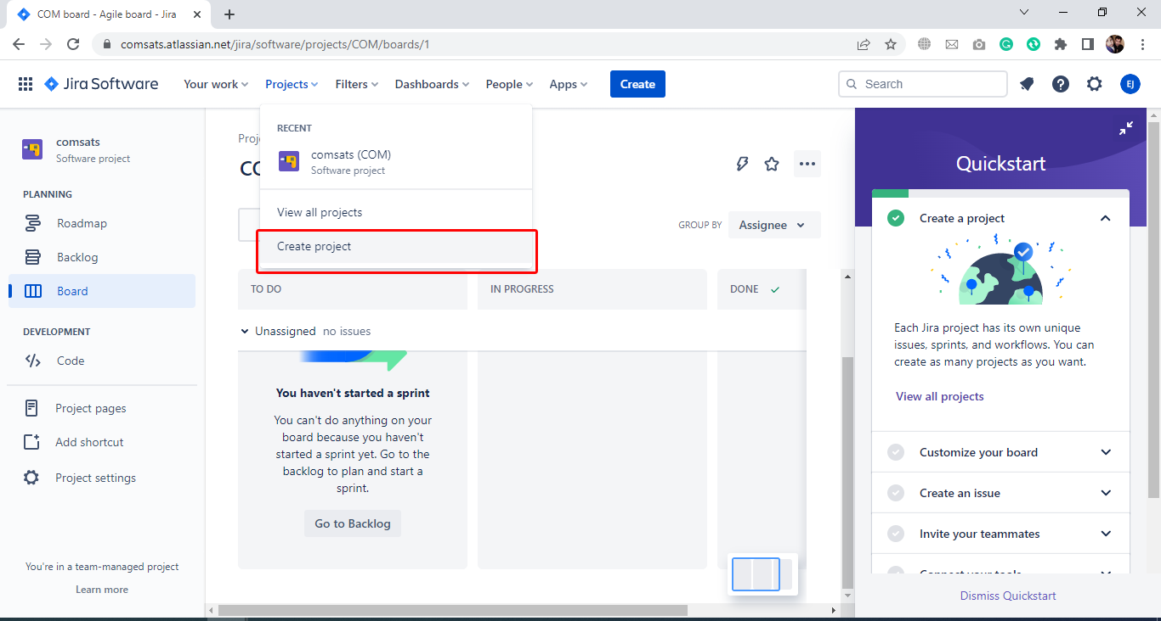
Create a New Project in JIRA (Cont.)

Slide 15
Create a New Project in JIRA (Cont.)
Choose the type of Project that suits your requirement and the process it should follow.
The following screenshot displays the type of projects available in JIRA.

Slide 16
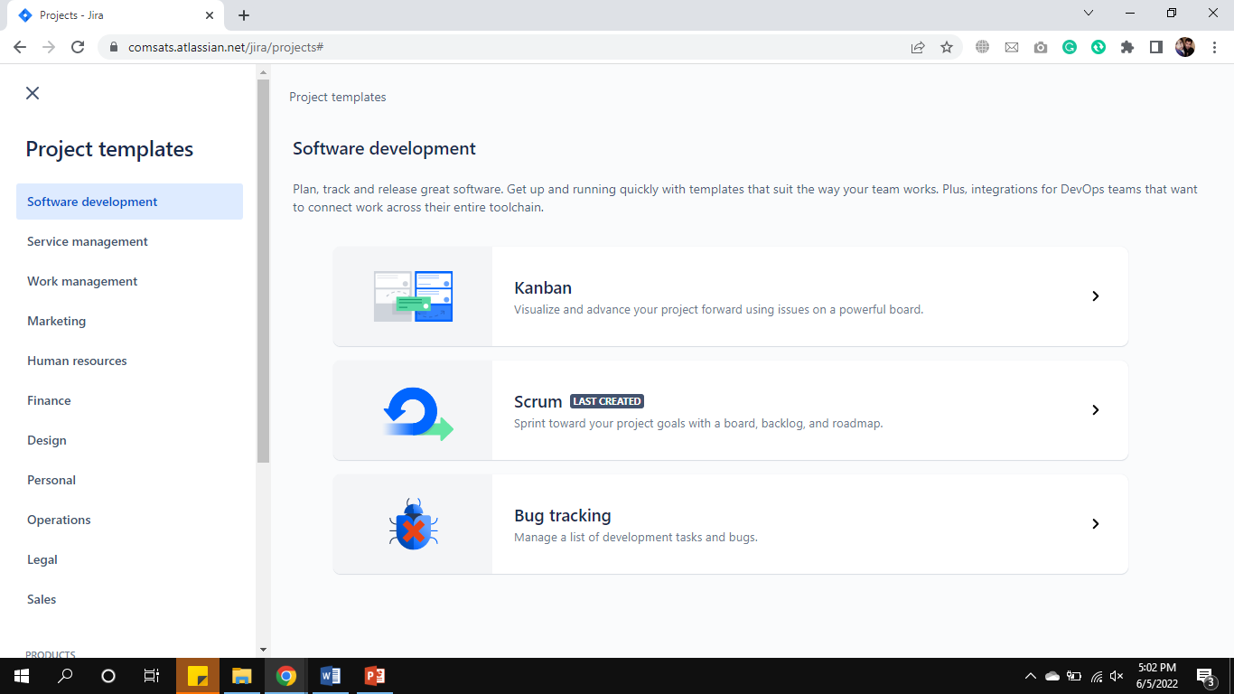
Create a New Project in JIRA (Cont.)

Slide 17
Create a New Project in JIRA (Cont.)
Once the type of project is selected, click on Next. The user will see the flow of the project based on the selection. Here, we have selected Basic Software development.
The following screenshot displays the available issue types and the workflow for the chosen project in the step mentioned above −

Slide 18
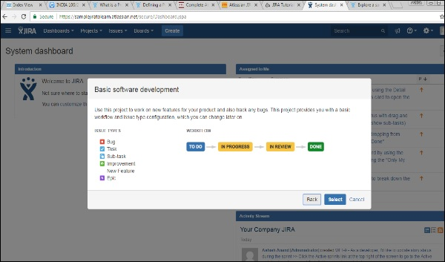
Create a New Project in JIRA (Cont.)

Slide 19
Create a New Project in JIRA (Cont.)
Click on the Select button, enter the name of the project and confirm the Key that the user wants to display as a reference in all the issues. Once this is done, click on the Submit button.
The following screenshot displays the fields to provide details before the creation of a project.

Slide 20
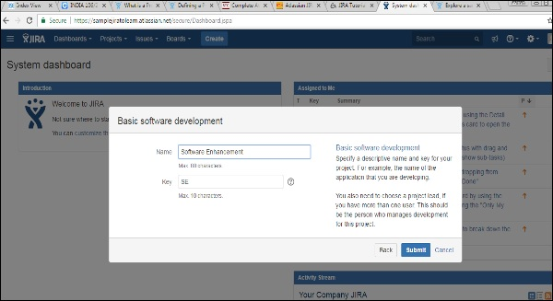
Create a New Project in JIRA (Cont.)

Slide 21
Create a New Project in JIRA (Cont.)
The page having issues will display.
The following screenshot displays whether any issues are linked with a new created project.

Slide 22
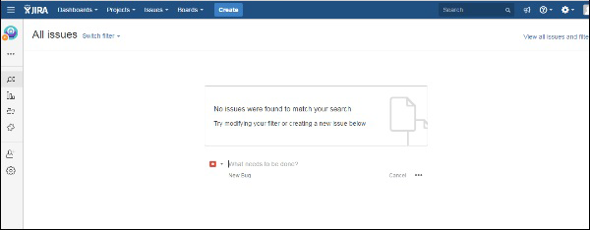
Create a New Project in JIRA (Cont.)

Slide 23
Thanks
…?

